Slide 1


HotDocs – An Introduction

Slide 2
Introductions
AbacusNext
  <Name> - Enterprise Sales Manager
  <Name> - Technical Pre-Sales
Your Organisation
  <Name> <Role> <Aims for the meeting>
  <Name> <Role> <Aims for the meeting>
Notes:
Good afternoon everyone my name is [Account Holders name] I’m the Senior Enterprise Sales Manager at AbacusNext and today I’m joined by [Pre-Sales Persons name], [Pre-Sales Persons first name] is the Technical Pre-Sales Engineer for HotDocs. I’ll take just a few minutes to set the scene a little bit and then hand over to [Pre-Sales Persons first name] for the demo and then at the end we can drill down a little bit on what you are trying to achieve with document automation.
Going forward I will be your main point of contact and will be helping provide you with all of the technical and commercial information you require to hopefully make a positive decision about HotDocs.

Slide 3



AbacusNext – About Us
1994
HotDocs Desktop
2001
HotDocs Server (API)
2006
HotDocs Server (Web API)
2012
Cloud Services (Cloud API)
2013
Document Services
HotDocs Market
2018
HotDocs Advance
Extended APIs
Standard Web User Interfaces
  HotDocs acquired in 2017 to become International arm of AbacusNext
  Pioneer and global market leader with 25 years’ experience
  Circa 1.5 million users worldwide across more than 11,500 customers
  Currently deployed in over 60 countries with offices in the
  UK / US / Canada and a large network of over 50 global partners
  Proven technology across multiple sectors including Banking, Legal and Insurance
Notes:
The primary focus of today’s meeting is the demo which we’ll run through in a few minutes but I think it is worthwhile giving you a brief overview and understanding of AbacusNext and the HotDocs product line…<CLICK>
HotDocs have been delivering Document Automation for a while, 25 years to be precise. And we have evolved to stay at the forefront of technology and deployment trends.
<CLICK>
HotDocs were acquired in 2017 by AbacusNext, who are backed by Providence private equity ($54bn under management). What does it all mean? Basically the acquisition has strengthened and deepened the HotDocs resource pool & investment capability.
<CLICK>
HotDocs was a pioneer in document creation automation and effectively created the industry over 20 years ago. AbacusNext is now by far the largest supplier of document automation software in the world through the HotDocs product line.
<CLICK>
We’ve done this a few times now with around 1.5M users worldwide and 11,500 organisations utilising HotDocs to overcome their document generation challenges and to improve efficiency and reduce cost, so we do have a good understanding of your world in that sense..
<CLICK>
The solution is deployed in over 60 countries and we have offices in the UK/US/Canada as well as working with a network of global partners to service those geographies
<CLICK>
The software is proven across multiple sectors with a strong presence in Law and Banking both of which, as far as document creation is concerned have the perfect document automation conditions of a high volume of documents, high complexity in a highly regulated environment. What’s also important to note is that the same technology can be adopted by and applied to small firms, effectively from single users to global corporations the only difference being the infrastructure to scale the adoption of HotDocs
<CLICK>

Slide 4



























Customer Base
Legal
Financial Services
Real Estate / Retail
Selected Others
Notes:
This slide gives you an overview of the verticals we service and some of the key customers within those.
RBS is one of our main customers and they have a highly integrated solution which lies at the core of their lending platforms, so when anyone applies for lending whether it be through their customer lending application platform or if you are in a branch talking to a relationship manager if you apply for lending you with be completing a HotDocs questionnaire! Thousands of users across the organisation creating millions of lending documents all powered through HotDocs.
The key here is to demonstrate that there is not just a focus on Legal and Financial Services – the software is content agnostic, it doesn’t care about the specific content and can solve business challenges across many sectors. We help all these clients solve some pretty complex and high volume challenges with document automation.
<CLICK>

Slide 5
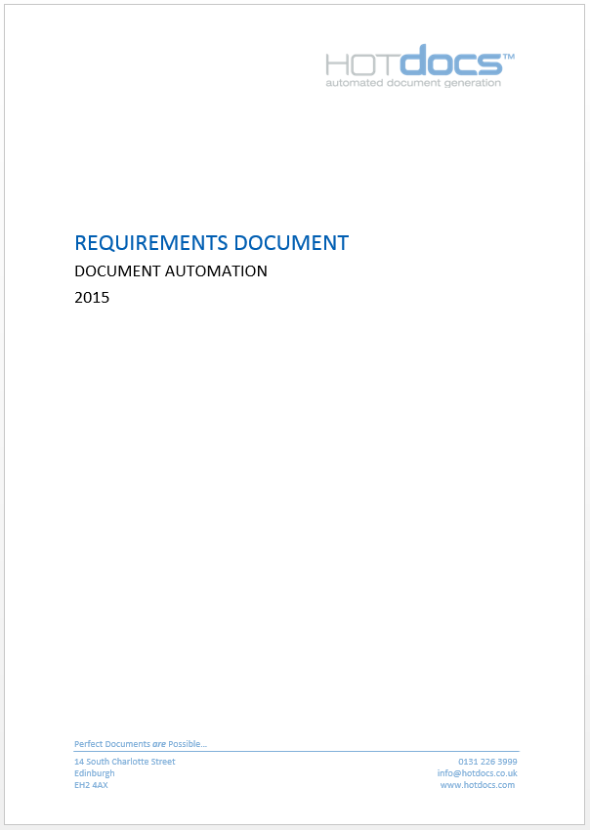
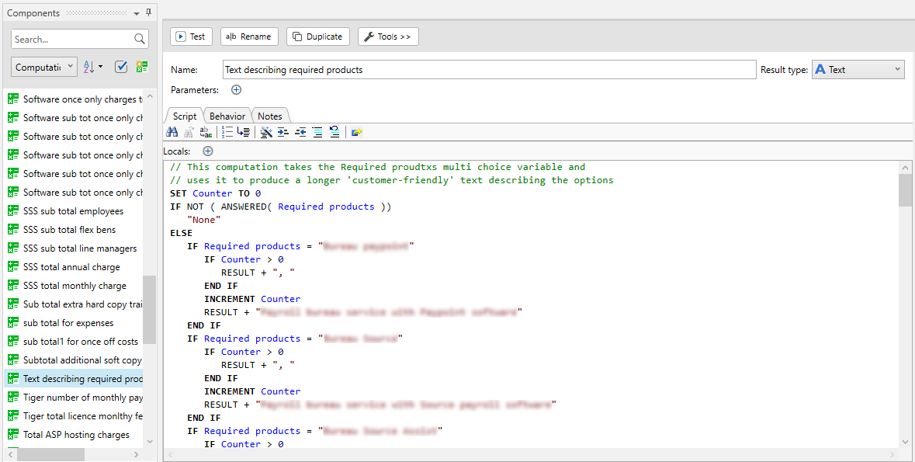



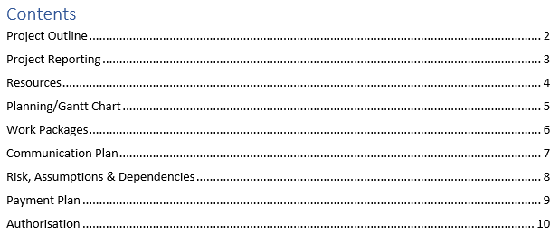
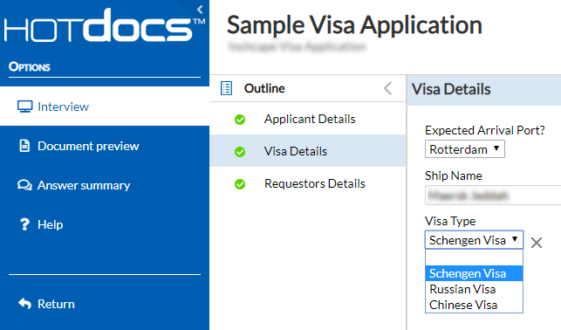



Why HotDocs
Branding
Compliance and Risk
Standardisation – Format and House Style’s
Fonts
Standardisation – Content and Calculations
Efficiency
Cross references and TOCs
Accurate
Agile and Maintainable
Accessible
Comprehensive
Headers and footers
Notes:
For any organisation that needs to produce repeated documents as part of their business process, for example contracts, agreements, letters, etc., HotDocs provides a solution that can ,
<CLICK>
Minimise the risks due to user error and common cut and paste approaches to document production. HotDocs provides the ability to ensure the organization is creating documents in line with how the business wants them to be created. This mitigates the risk of issuing documents which are inaccurate and expose the company commercially.
<CLICK>
At the same time, your users will expend less effort sourcing the most appropriate document to re-use, ensuring compliance with internal standards by providing control over the format of your documents making sure that headers, footers, branding, fonts, house styles etc. are all unified.
<CLICK>
More important than a consistent look and feel is the content. HotDocs templates provide capabilities for reusing the same content, transforming the content for data standards, forcing Gender Pronouns, calculating variables based on other values. We can pull in content from Auxiliary Templates based on the answers to simple questions or complex calculations. Eradicating errors caused by exclusion or inclusion of content. Only asking the questions that are relevant in an intuitive interview interface.
<CLICK>
And of course one of the biggest benefits is efficiency! Obviously it depends on the complexity, size and content and how your current procedure for producing documents operates, but for the common approach of copying/pasting and manipulating already constructed documents to produce new copies, you should see a reduction in time taken of approx. 80%
One of our large customers ran a verification of the efficiencies gained and they found that when they ran their normal document creation process on one of their main documents, it took an average of just over 3 hours with an average of 6 mistakes and then repeated the exercise with a HotDocs Template which took an average of 15 mins with 0 errors

Slide 6






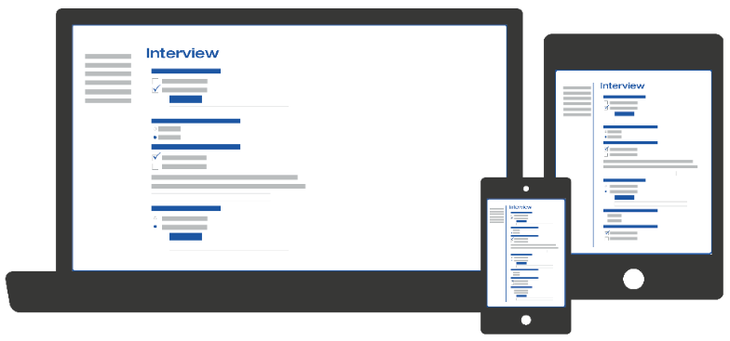





Usage Scenario
CONTENT
AUTHOR
DOCX
USER
Notes:
There are two parts to using HotDocs, Template creation and then the use of those templates by end-users to Create Documents.
<CLICK>
Template Creation is carried out using a desktop application called HotDocs Author. This is typically carried out by a small group of users in the organization who are familiar with the structure of the <CLICK> documents that are to be turned into templates, so Author only needs installed on those users’ PC’s. <CLICK> The Author application is tightly integrated to Microsoft Word and allows template authors to take existing Word documents and easily turn them into HotDocs templates, replacing all the variable parts of the document with HotDocs components, <CLICK> and building in business logic to control inclusions and exclusions and other aspects of the document content.
<CLICK> Once an author has created a template they then upload it to the HotDocs Advance server. <CLICK> End-users can then use the HotDocs Advance user interface to create new documents from these templates. As this user interface is browser based it can be accessed from laptops, tablets, smartphones, etc. The template presents what we call an “Interview” to the user which prompts them to enter answers for all of the variables contained within the template. <CLICK> These answers are then passed to the back-end HotDocs engine to assemble the completed document (or documents). <CLICK> The answers provided by the user are also stored alongside the finished document in what we call a Work Item, and we’ll see in our demo how this can be used to gain efficiencies in creating new or updated documents.
So in this way document generation becomes a very quick and controlled process, allowing users to produce documents much more efficiently and with much lower risk of costly mistakes.

Slide 7
HotDocs – Demonstration

Slide 8
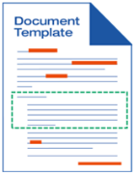


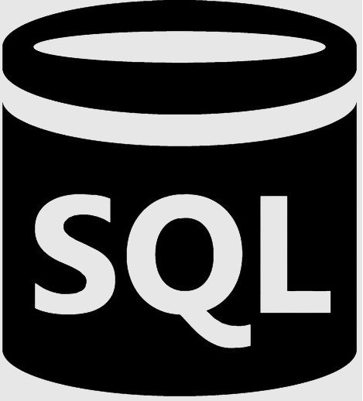
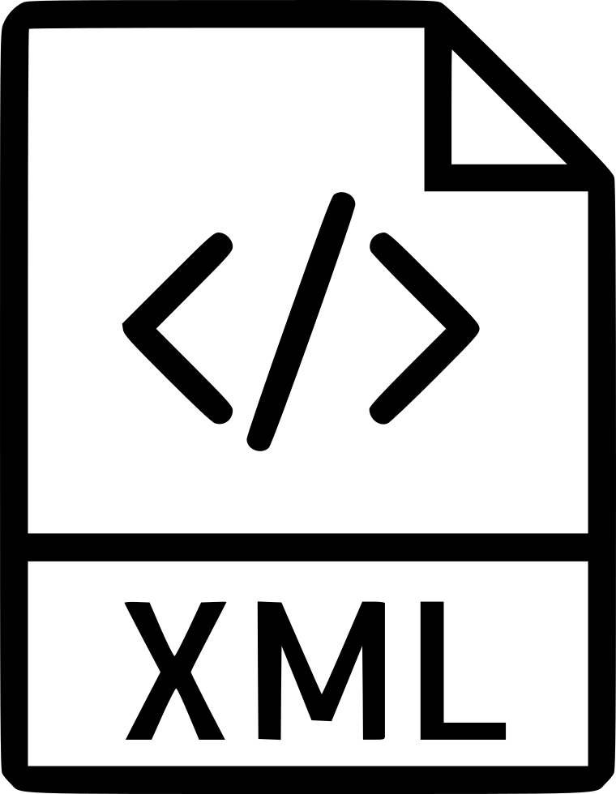
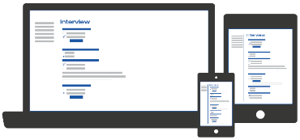

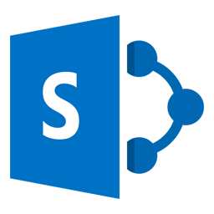


Alternative Usage Scenarios
Template Authoring
Out of the Box User Experience
HotDocs Author
The Interview
Advance UI
HotDocs User
Advance
REST API
Data
Input
Document Output
Pre-Interview Event/Process Data Input
Post Assembly Event/Process
Third Party Systems
End User (utilizing UI of custom application)
Third Party Systems
Custom Application
Notes:
Now before we finish I just want to mention that there are actually two means of consuming HotDocs document generation services
There’s the Out of the box method, as we’ve just seen,
Or, you can access HotDocs services from your own custom application via the HotDocs APIs
<CLICK>
In both scenarios Template creation is exactly the same and as we’ve seen uses a desktop tool named HotDocs Author that is strongly integrated with Microsoft Word. This allows non-technical users to easily create templates from your existing documents, without requiring IT or coding level knowledge to create or maintain these.
Templates are then uploaded to the HotDocs Advance server for consumption by end-users.
<CLICK>
For OUT OF THE BOX end-user access, they use the browser based Advance user interface that we’ve just seen in the demo to create new documents. By running through the user Interview process defined by the templates, the user interactively provides all the necessary data to allow the document to be assembled and then downloads the resulting Word or PDF document.
<CLICK>
If you have any more complex document assembly requirements, for example;
You want to prepopulate the interview automatically with data retrieved from an external data source, or
You want to completely automate document generation using batch processing of data in an external data source rather than have any user interview at all, or
You want to automatically place the completed document into a Document Management System, or pass it to a Workflow tool for user approval, or send it automatically to an eSignature system, or
You want to embed the entire document generation process, including the user Interview within another application or in a Website,
then you will be looking at the next scenario, where you will be using HotDocs as a back-end engine only, and writing a custom application that consumes HotDocs templates and assembly services via our API.
This is what commonly gets called an Integration Scenario and is, by the fact that a bespoke application needs written, a much more complex project than simply using HotDocs out of the box.
And notice that, as soon as you are looking at using a custom application, users are no longer using the inbuilt HotDocs user interface. They are using a custom application that accesses HotDocs services. So that application needs to provide a user interface and everything else that goes along with it.
Now it may be that you have mixed requirements, in that some users’ or departments’ document production needs can be fulfilled via the out of the box functionality of user driven interviews only, whereas others need a more complex scenario requiring a custom application, and in that case you can have a hybrid approach. And in that case we would recommend a phased approach to the delivery. Much of the benefit of HotDocs is achieved through the powerful Template and Interview functions alone. Going further by automating these with the support of a third-party system may help with marginal gains, but don’t let the potentially protracted development of a custom application delay the delivery of the majority of the benefits. So Phase 1 would focus on deployment of Out of the Box HotDocs and getting your templates in place to get some quick wins.
Phase 2 can be delivered almost in parallel, normally slightly staggered to gain project insights and delivery of the templating. A Custom Application can either be delivered by ourselves, your team of developers or by a third party. We will deliver API training to your team or a third-party if that is the route you prefer.
And finally I’d also point out that our product plans are that the out of the box HotDocs system shall start to have more extensibility, allowing your users to use the standard user interface in conjunction with custom applets for aspects like data input from 3rd party systems, or document output to DMS, workflow or eSignature’s but for now those integrations are achieved using a complete custom application leveraging HotDocs services via our APIs.
[If asked for further detail about how a Custom Application could work, else open the call to questions]
The basic requirement is that any custom app (wherever it resides) is able to;
make RESTful API requests to HotDocs (via our API)
embed a HotDocs interview (which is provided via the API as javascript) within your UI – possibly in an iFrame
compile your data into suitable HotDocs Answer XML format for submission to HotDocs via the API
retrieve assembled documents via our API and make them available to end users in your UI – e.g. as download links

