Slide 1


HotDocs – Sales Training
July 2019

Slide 2
HotDocs – Agenda
  Session 1
  HotDocs benefits - Out of the box vs Integrations
    Value proposition of Out of the Box HotDocs
    Impact on sales cycle/costs/complexity of Integrations
  Qualifying the business need
    Establishing their requirements
    Is it a fit?
  Upselling Template Training & Consultancy
  Session 2
  Demo training
  General HotDocs Q&A
2
Notes:
The idea of the first session is to give you all some feedback from the pre-sales technical perspective on what works and what doesn’t in terms of selling HotDocs. Historically we’ve seen quite a lot of opportunities being worked on that end up unsuccessful, and we just want to make sure you are aware of some of the common pitfalls and can avoid those, as well as some of the upside opportunities that will help you and your customers.
The second session will focus on how to deliver a HotDocs demo as well as giving you the opportunity to ask any questions you may have around HotDocs – some of which I may even be able to answer.
--
Let’s start off by talking about what HotDocs is

Slide 3
HotDocs – Out of the Box
Elevator Pitch - The What, Why, and How of HotDocs
  “For organisations that need to produce repeated documents as part of their business process, for example contracts, agreements, letters, etc., HotDocs provides a solution to,
    vastly increase efficiency in document production,
    whilst minimising the risks due to user error and common cut and past approaches,
    at the same time as ensuring compliance with internal standards and external regulations.
  It achieves this by giving you the power to easily turn your existing Word documents into HotDocs templates, defining all the variable data and parts of the document, as well as building in intelligent business logic to control optional content.
  Through tight integration with Microsoft Word HotDocs allows,
    non-IT users to easily create and maintain templates,
    leveraging all the formatting and language capabilities of Word.
  Once you have created these templates, end-users can use a simple browser based interface to run through an interview of questions which is automatically built as part of the template. The user simply answers the questions in the interview, then HotDocs assembles the completed document and presents it to the user.
  In this way HotDocs can vastly transform document production for your organisation.”
3
Notes:
This is an example Elevator Pitch for HotDocs.
Everyone working with HotDocs should be able to provide a short elevator pitch on it,
What is it for?
Why would I want it?
How does it work?
So let’s read through it…
And one of the key things is that everything said here is true of HotDocs straight “out of the box”

Slide 4
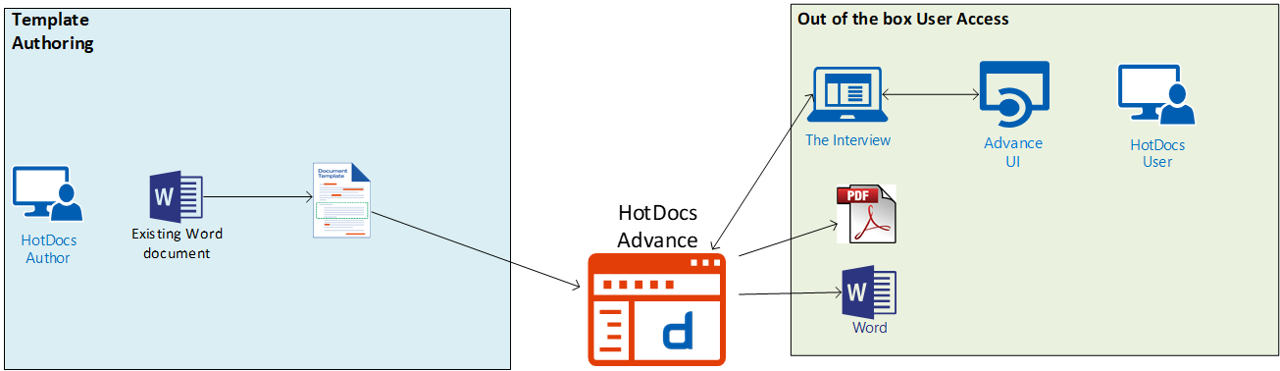
HotDocs – Out of the Box
  What do we mean by out of the box ?
    Templates are created using HotDocs Author desktop tool (integrated with MS Word)
    Templates are uploaded to HotDocs Advance component to make them available to end users
    End users log in to the web interface of HotDocs Advance and select a template that’s been made available to them
    They provide the answers to the Q&A interview for the chosen template and their answers are used to assemble a finished document(s) (DOCX or PDF)
    End users are provided with a download link for the assembled document(s)
    Users download the document and do whatever they want with it (post assembly actions)
4
Notes:
It’s important that we can distinguish between the functionality and operational mode of HotDocs as it comes out of the box, versus how else it can be used.
So let’s start of by looking at what we mean by out of the box?
If I install HotDocs for a new customer what do they get the ability to do.

Slide 5
HotDocs – Out of the Box – Business Benefits
  Efficiency Savings
    Complex document production down from several hours to minutes
    Simple document production times down 80-90%
    Straightforward costs savings calculation – if you track average document production times and resource costs
      e.g. 100 employees spend on average 2 hrs per day in document production @ avg. earnings of $25 per hour = $5000 per day
      So an 80% reduction = a $4000 per day saving
  Risk and Error Reduction
    #1 Benefit for some customers, e.g. HSBC
    Common document production methods are highly prone to error, and errors carry a high risk of costs
    ROI more difficult to calculate – dependent on how often mistakes happen and how much they could cost
  Compliance
    Ensure that internal standards are being complied to
    Ensure that external standards are being complied to
    Guarantee everyone is using the latest revision of your templates
5
Notes:
And what benefits does an organisation get from using HotDocs in that way?
There are three main areas of benefit.

Slide 6
HotDocs – Out of the Box vs Integrations
  Elevator Pitch
    Doesn’t mention any integrations except the one with Microsoft Word
    Because….
      That is the ONLY integration built-in to HotDocs
  Other HotDocs Integrations
    Require custom applications which consume HotDocs services via our APIs
      Other applications connect to HotDocs – HotDocs does NOT connect to anything
  Business Benefit
    90% of business benefit comes from,
      Efficiency savings in document generation
      Reduction in costly mistakes from other methods of document production
      Compliance with internal and external standards
    Most of this comes from Out of the Box HotDocs functionality – extra integrations are just an (expensive) icing on the top.
6
Notes:
So bearing all of those in mind, and the fact that we can get all of those from HotDocs out of the box, let’s look now at a different way of using HotDocs

Slide 7
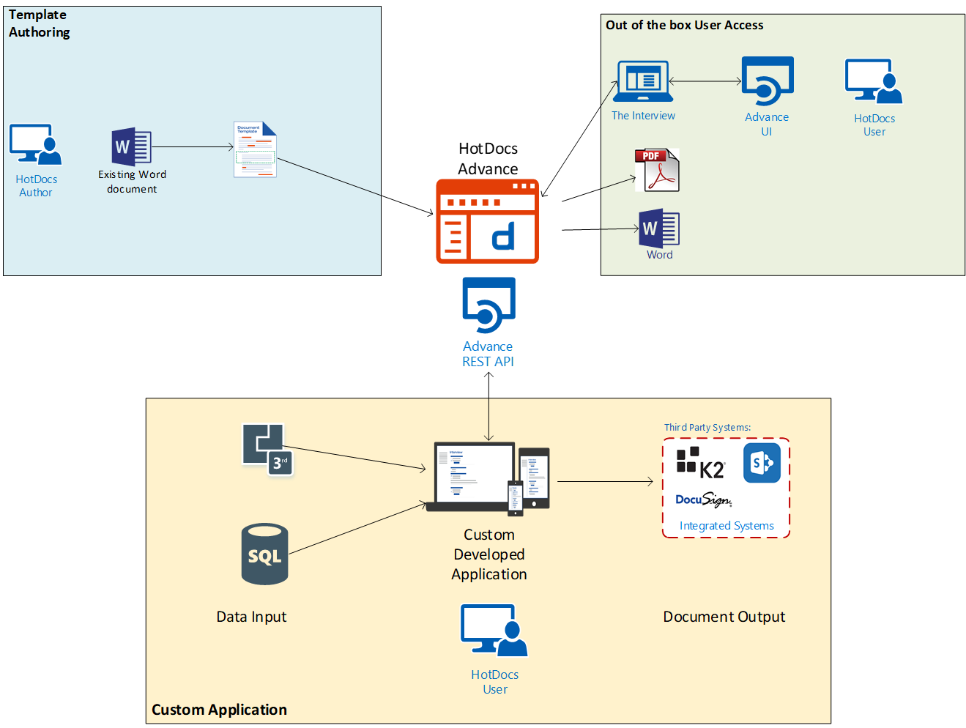
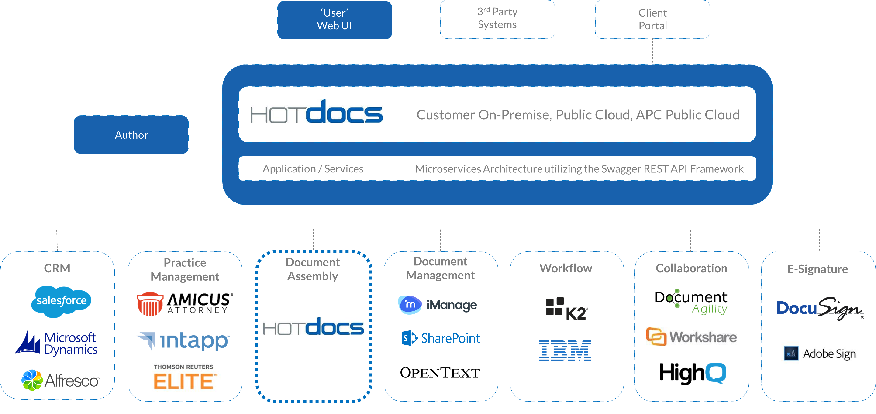
HotDocs – Out of the Box vs Integrations
  What do we mean by Integrations?
7
Notes:
But it’s important that we understand what Integrations actually are.
<Click>
Have you seen this slide? If so… get rid of it! It has caused more problems than any other slide in the history of HotDocs.
HotDocs does not come with integrations for all of these products… <CLICK> it doesn’t come with integrations for ANY of these products!
We need to be careful about customer expectations when we show slides like this. If you have slide decks with this slide STOP using them.
So what do Integrations actually look like?
<Click>
If you have any more complex document assembly requirements than the out of the box functionality, for example
You want to prepopulate the interview with data retrieved from some other system, or
You want to completely automate document generation using batch processing of data from another source rather than use user interviews, or
You want to automate post-assembly actions, for example place the completed document in a DMS system, or pass it to a Workflow tool for user approval, or send it automatically to an eSignature system, or
You want to embed the user Interview within another application like Salesforce or a Website
then you will be looking at the next scenario of using HotDocs as a back-end engine only and writing a custom application that consumes HotDocs templates and assembly services via our API.
This is what commonly gets called an Integration Scenario and is, by the fact that a bespoke application needs written, a much more complex project than simply using HotDocs out of the box.
And notice that as soon as you are looking at one of these scenarios, users are no longer using the inbuilt UI. They are using a custom application that accesses HotDocs services. So that application needs to provide a user interface and everything else that goes along with it.

Slide 8
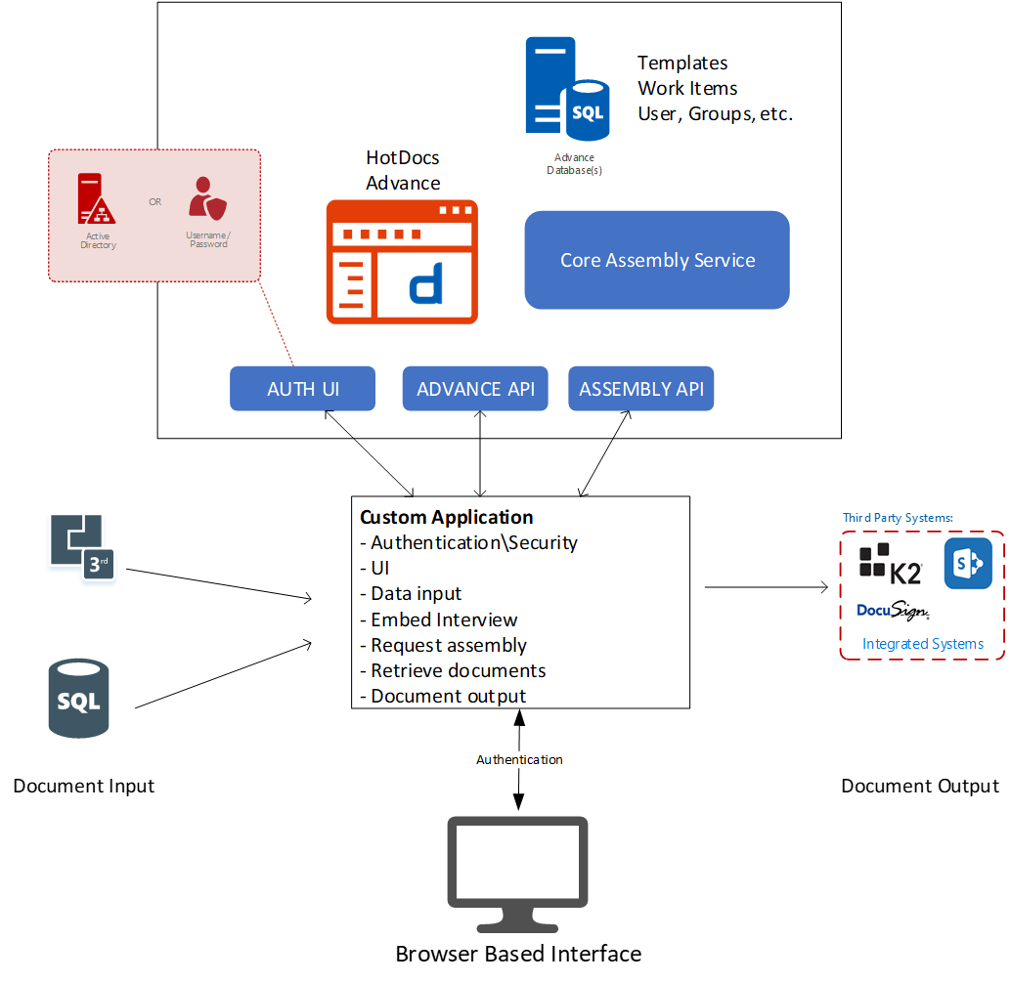
HotDocs – Integrations in more detail
Complexity!
8
Notes:
Don’t be intimidated by this slide – the key fact is Integrations are COMPLEX!
For those that want more info:-
This diagram is simply trying to show the scenario where a customer is not using simple out of the box access with purely user interview driven template completion.
In this scenario a custom application is required which users are going to log in to. That applications needs to provide,
Authentication and any additional security functionality required - now it may piggy back on the back end Advance authentication UI but in a lot of cases organisations want their own branded login page, so that means they can’t use the Advance Auth UI. In the same way they can piggy back on Advance security constructs like user groups and work groups that are exposed via the API, but if they have custom security requirements beyond those capabilities, and they often do, then that also needs coded into the custom app.
A user interface – the application needs to provide the full user interface (assuming there is user interaction require – which for batch processing document automation scenarios isn’t necessarily the case). Because of this these custom apps are almost always web applications providing a browser based interface for end users.
Data Input – the application is responsible for all interfacing with 3rd party systems (databases, CRM, practice management, ERP, etc.) and retrieving any data from those systems that needs to be used as answer data to HotDocs templates. Part of this is the maintenance of mapping files which define the mapping of third party data fields to HotDocs template variables. Consideration also needs given to what lookup fields are going to be used to retrieve any of this data – e.g. does the user need to provide a Client ID to dictate which records are read in the 3rd party systems
Interview – for scenarios where some data is being retrieved from data sources but other answers are still being provided by the end user, an interview shall still be required. This can be retrieved via the API and embedded within the application’s UI
Request Assembly – the application shall be responsible for building the answers into HotDocs Answer XML format and passing these back through the API to allow the HotDocs Core Assembly Service to assemble the completed document(s)
Retrieve Documents – once document assembly is complete the application uses the API to retrieve the completed document(s)
Document Output – once the documents have been prepared the application can then present these to the user for download, or pass them to any required third party systems (DMS, eSignature, Workflow etc.)
This is just a typical set of responsibilities for such a custom application. Each customer scenario is unique and requirements need scoped out accordingly.

Slide 9
HotDocs – Integrations – Business Benefits
  Added Efficiency Savings
    Users don’t need to rekey data held elsewhere
      BE CAREFUL – why spend thousands on an integration to save 30 seconds of a users time when Out of the Box functionality has already saved you 2 hours!
    Enables fully automated scenarios, i.e. no user interview
      Documents that are suitable for this are few and far between
    Automates post assembly actions, e.g. placing documents in DMS, Sending documents for eSignature, etc.
      BE CAREFUL – are you automating something that users can easily do post assembly?
  Risk and Error Reduction
    Users don’t need to rekey data held elsewhere
      BE CAREFUL – How sure are you that your data sources are accurate – if users aren’t entering the data, they typically won’t check it either
  Embed HotDocs in some other System/Website – e.g. Salesforce, Website for clients
    Users don’t need to switch interface
    Expose HotDocs to external users
9
Notes:
So if they are complex why do some customers want integrations?
Well there are added benefits – we just need to be careful about some of them

Slide 10
HotDocs – Integrations – Drawbacks
  Added Costs for potentially marginal gains
    A Custom application needs developed
      Added cost of development – whether we do it or the customer does it
    Custom applications are NOT included in HotDocs support from AbacusNext
      Currently any support on custom apps would need paid for professional services time.
  Sales Cycle Stretches
    Customer requirements for integration take time to scope
      Additional thinking for customer to do
      Scoping process for AbacusNext pre-sales and pro-services to do (PSE process)
      Sales cycle stretches to around 4-6 months and in some cases 6-12 months!
      Integrations compromise our price model and push into a space where custom application designers can compete
10
Notes:
But these benefits come at a cost… both to the prospect and to us
----

Slide 11
HotDocs – Out of the Box vs Integrations
  In Summary
  Keep it simple – make more $$$
    Keep customer focused on Out of the Box benefits and functionality for a quicker easier sale
    If Integrations are required, be prepared for a lot more work
      If you need to deliver integration services, try to position it as a phase 2 deliverable. Phase 1 is the delivery of HotDocs and Phase 2 is the integration of HotDocs with the other services – we can prove the ROI and focus the client on immediate Low Hanging Fruit.
    Upsell opportunity for Template Consultancy & Training (more later)
11
Notes:
So to summarize the position regarding Out of the Box HotDocs vs Integration scenarios…
---
Now I want to move on to another potential pitfall in selling HotDocs. But before I do are there any questions around out of the box vs integrations?

Slide 12
HotDocs – Qualifying the Business Need – The Prospect
  Brief business bio – What do they do as a business?
    How do repeatable documents fit into their business process?
    Type of documents they currently produce, are they simple or complex?
  Do they use document automation currently?
    Home grown system
    Competitor solution
    Previous version of HotDocs
  Expansion on current process for document production,
    Number of people involved generating or utilizing current documents.
    Effectiveness of the current process, including challenges, errors and inefficiencies.
  What do they perceive as the benefits of using HotDocs?
  Do they have a specific time critical event? When do they want to start process?
  Budget and appetite to proceed.
  Are we speaking to the decision maker? If not who is that and when can we speak to them?
12
Notes:
So now lets talk about how we ensure HotDocs is the correct fit for the customers requirements.
When you are speaking to HotDocs prospects there are some key elements you need to gather to get a good idea of their needs and to help you be able to communicate the benefits of HotDocs, and decide whether this is a real opportunity or not.

Slide 13
HotDocs – Qualifying the Business Need – HotDocs Fit?
13
Notes:
Quite often when talking to prospects about their requirements you are going to come across two other common areas of functionality, Document Management and Contract Lifecycle Management
<CLICK>
HotDocs helps automate document generation, i.e. the initial drafting of documents
It does NOT provide Document Management or Lifecycle Management
So HotDocs focuses on,
Creating templates to facilitate efficient document generation
Using those templates to assemble new documents
It does NOT deliver the typical features of Document Management or Contract Lifecycle Management
<CLICK>
Document Management focuses on
Document storage
Version control
Searching
Sometimes, Workflow/Archiving etc.
Contract Lifecycle Management (CLM) is about managing the typical stages of a contract,
Contract creation (HotDocs can do this)
Contract Negotiation
Reviewing and redlining
Approval
Execution
Contract storage, search, and retrieval
Contract renewal etc.
<CLICK>
HotDocs can act as an input to both of these types of systems, either by having the user place assembled documents into the appropriate system manually, or in an integration scenario, having the custom application move the assembled documents into the other system automatically (assuming it has an API or other suitable interface).
Be clear with the prospect though. It is the document creation phase where HotDocs works and provides benefit – we do not offer DMS or CLM capability.
This is an important distinction and we need to make sure that we are capable of doing what the customer is after. If it turn out they really want DMS or CLM functionality, then don’t waste any more time on this.

Slide 14
HotDocs – Upsell Template Consultancy
  Template Creation is THE critical success factor of any HotDocs project
    Customers need to invest time and resources in getting this right.
  We can help
    Professional Services offer,
      Template training
        Core and Advanced: one day training packages
        Bespoke training on specific concepts or documents
      Template Consultancy
        We can get them started by taking on production of some of their templates
        Focus on quick wins or complex documents
  If they get it right there are upsides for us
    Expansion throughout their business
      More licenses
      A stickier solution – longer term subscriptions
14
Notes:
Now as a final topic lets take a look at another opportunity you have to upsell on your HotDocs opps.
Beyond the customer’s core requirement for HotDocs, you have more opportunity…
From speaking to past customers that have been through the process of a document automation project, the #1 thing they tell us about the key factors for success is that an organisation MUST invest time and resources in building their templates.
If they get the templates right then they gain,
Maximum benefit in all of the key areas (efficiency, risk and error reduction, compliance)
Improved buy-in from the other parts of the business (any department with end-user)
Approval to expand document automation to other areas (more licenses for us!)
We need to educate prospects about this key part of their project, and in order to help them get this phase of their project right we can offer assistance.

Slide 15
HotDocs – Avoid Template “Proof of Concept”
  Proof of Concept (PoC)
    Used to prove that we can do something that is NOT standard functionality
      e.g. prove that we can write a custom application to take data from SAP Success Factors and feed it into a HotDocs interview
    There is no need to “prove” we can do core functionality of HotDocs
      e.g. templating of a particular document
  For any customer wanting to know whether documents can be templated with HotDocs
    Thousands of happy customers
      Case Studies
    Some very complex documents
      HSBC & RBS banking documents
      Many of the largest legal firms contracts and agreements
      HotDocs has the market leading templating engine
      Templating is the core feature of our solution – if our templating didn’t work we would be out of business
  If they insist – it’s a paid Pilot not a PoC
    Needs scoped – need marked up copies of their documents to allow us to scope effort
15
Notes:
On the topic of templates though, another common pitfall that we see coming up time and time again is the idea of doing a Proof of Concept to show that HotDocs can template some specific documents.
A proof of concept (PoC) is only relevant when we are having to prove that we can do something that is not standard functionality, e.g. “we want to prove that you can integrate with CRM system, xyz”. We do NOT do Proof of Concepts to show that we can do document templating or any other core out of the box functionality. That would be a trial or pilot. If people need further reassurance that we can “do” core functions then that is what case studies and the fact that we have sold to thousands of customers shows, it doesn’t need to be “proven” in a proof of concept. If they insist, then it’s a Pilot and will almost always involve services work and as such would almost always be a chargeable exercise.

Slide 16
HotDocs – Summary – Selling the Benefits of HotDocs
  HotDocs is a best of breed Document Generation solution
    Don’t try to sell it as DMS or CLM as that will just weaken the message
  Out of the Box benefits are significant
    Efficiency Savings
    Risk & Error Reduction
    Compliance
  Integrations add complexity
    Keep it as simple as possible
    The majority of the benefit comes from out of the box functionality
  Ensure you understand their need
    How do they produce documents at the moment
    What type of documents
    Timeline and budget
  Sell HotDocs (Out of the Box)
  Upsell Template Consultancy & Training to help customers ensure success
    Avoid templating PoC’s
16
Notes:
OK.. To summarize…

Slide 17
Questions?

Slide 18
Thank You

