Slide 1
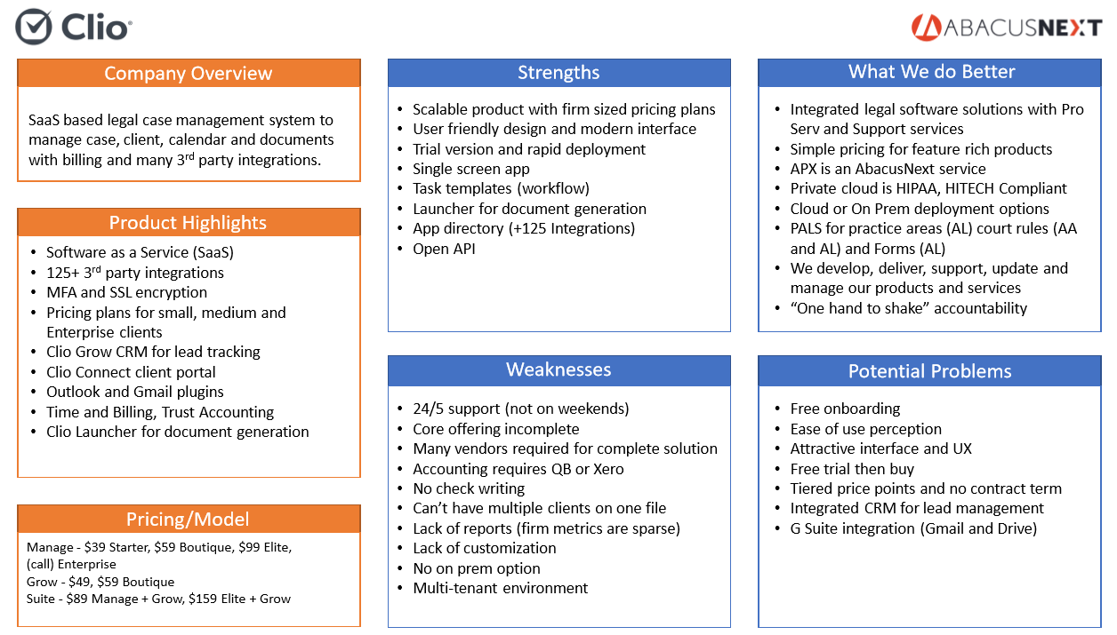

Slide 5
Company Overview
Strengths
What We Do Better
Web-based time and billing and law practice management software.
User friendly design and simple interface
Insurance Defense Module
Free Training through live webinars and “On-Demand” videos recorded online
7 day free trial
Integrations with 16 other law firm solutions including Dropbox, Google Calendar, Evernote, QuickBooks Online, Outlook, LexCharge, O365, Skype
Award-Winning Customer Support for Five Consecutive Years
Case Management AND Accounting Solution
On Premise deployment option
PALS for practice areas (AL) court rules (AA and AL) and Forms (AL)
We develop, deliver, support, update and manage our products and services
“One hand to shake” accountability
Option to be deployed in Abacus Private Cloud (APC) our Hosted Environment
Product Highlights
Software as a Service (SaaS)
3rd Party Integrations
Invoicing, Time Tracking, Expenses
Automated Document Production
Unlimited Data Storage
Mobile Access
Free Trial Available
Client Portal
Rocket Matter Payment via credit card or eCheck
Weaknesses
Potential Problems
Designed for Small Firms
No Mobile App
Accounting requires QBO
No on-premise solution
Multi-tenant environment
Price is competitive
Time to implement is lower
Free trial
Easier to learn the interface/workflow
Everything is in One Place
Pricing/Model
$55/user/month (annual billing)
$65/user/month (monthly billing)

Slide 6
Company Overview
Strengths
What We Do Better
Cloud-based practice management solution built on Salesforce, assisting small to large legal firms with case screening and client management.
SaaS Salesforce Interface
Marketing, Client Management, Intake and Referral Automation
Excellent Reporting for Marketing Campaigns
Optimized for Mobile Devices
Intuitive UI
Billing and Invoicing
Document Assembly and Management
Rules-Based Scheduling
Highly Customizable
Case Management AND Accounting Solution
On Premise deployment option
PALS for practice areas (AL) court rules (AA and AL) and Forms (AL)
We develop, deliver, support, update and manage our products and services
“One hand to shake” accountability
Option to be deployed in Abacus Private Cloud (APC) our Hosted Environment
Product Highlights
CRM
Trust Accounting
Risk and Expense Tracking
Forecasting
Referral Management
Reporting
Mobile Device UX Optimization
Client Portal
Detailed Case Status Management
In Person, Online, Webinar and Documented Training
Weaknesses
Potential Problems
No offline options
Can experience latency
Expensive for SaaS solution
Minimal Integration Support
Customizations May Require a SF Administrator to Program
Too Feature-Rich for Some Users to Navigate Software Effectively
User Community is Very Satisfied
Attractive Features in One Solution
97% of Users Would Recommend to a Friend
Pricing/Model
$200/user/month

Slide 7
Company Overview
Strengths
What We Do Better
Cloud-based legal management, scheduling and accounting for small sized law firms with a handful of integrations including Outlook and QuickBooks Online.
High availability and SLA of SaaS
Online, Webinar and Documented Training
24/7 Support
MyCase App Bar and Open API
Integrations (Dropbox, G Suite, Google Calendar, QuickBooks Online, Outlook)
Staff Delegation and Workflow Ability
eSignature Integration
Electronic Payment Requests, ACH is Free
Case Management AND Accounting Solution
On Premise deployment option
One price for all product features
PALS for practice areas (AL) court rules (AA and AL) and Forms (AL)
Offer custom reporting
We develop, deliver, support, update and manage our products and services
“One hand to shake” accountability
Option to be deployed in Abacus Private Cloud (APC) our Hosted Environment
Product Highlights
Software as a Service (SaaS)
3rd Party Integrations
128-bit SSL encryption
Priced for Smaller Firms
Automated Document Production
Unlimited Data Storage
Web and Mobile App Access
Free Trial Available
Client Portal Login Notifications
Weaknesses
Designed for Small Firms
Clunkiness in Billing Processes
Limited International Client Features
Changes Need to be Saved Manually (no auto save)
No on-premise options
Difficult to Isolate Individual Time Tracking
Potential Problems
Price is competitive
Time to implement is lower
Free trial
Easier to learn the interface/workflow
Everything is in One Place
Pricing/Model
$39/user/month (annual billing)
$49/user/month (monthly billing)

Slide 8
Company Overview
Strengths
What We Do Better
Web-based all-inclusive practice management, legal billing and accounting software.
User friendly design and simple interface
Data entry and reconciliation using automatic data feed
Customizable Chart of Accounts
Income Statement by Attorney, Department, Practice Area
Free 1:1 Training, Setup, and Unlimited Support
Free Login for External Accountant or Bookkeeper
Electronic (LEDES) Billing
Fee collections & revenue distribution
On Premise deployment option
PALS for practice areas (AL) court rules (AA and AL) and Forms (AL)
We develop, deliver, support, update and manage our products and services
“One hand to shake” accountability
Option to be deployed in Abacus Private Cloud (APC) our Hosted Environment
Product Highlights
Email Management
Time & Expense Tracking
Trust (IOLTA) and Legal Business Accounting
Document Management/Assembly
Mobile App Access
Client Portal
Enterprise-Grade Features
Free, Unlimited Built-In Data/Document Storage
Weaknesses
Potential Problems
No offline options
Multi-tenant environment
User Community is Very Satisfied
Integrates with Gmail
Fully Integrated Practice Management, Billing and Accounting
99% customer retention rate
Pricing/Model
$69 per user/month (billed annually)
$79 per user/month (billed monthly)

Slide 9
Company Overview
Strengths
What We Do Better
A complete cloud-based legal productivity solution for small law firms interested in case/task management, automated timekeeping and billing.
Free Demo
Smokeball AI Automatically Captures Billable Items and Ensures Reporting and Billing are Engaged
In-Person, Online, Webinar and Documented Training
Microsoft Office Integration
Intuitive UI With Effective Workflow
Integration with ScanSnap, Campaign Monitor, RingCentral, InfoTrack, QBO
Ability to Search for Files Based on Document Contents Rather Than Title
Case Management AND Accounting Solution
On Premise deployment option
One price for all product features
PALS for practice areas (AL) court rules (AA and AL) and Forms (AL)
Offer custom reporting
We develop, deliver, support, update and manage our products and services
“One hand to shake” accountability
Option to be deployed in Abacus Private Cloud (APC) our Hosted Environment
Product Highlights
CRM
Automated Legal Forms
Automatic Time Tracking
Document Assembly
Mobile App
Case/Email Management
eSignature Support
Billing and Invoicing
Trust Accounting
Digital Filing
Weaknesses
Not Customizable for User Experience
Data From Other Software Cannot be Imported or Converted to Smokeball
Reporting Ability is Lacking
Useful Features Touted During Demos Disrupt Normal Billing Workflow
Geared towards smaller firms
Potential Problems
UI is Easy to Learn and Maintain
eSignature Support
Pricing/Model
Pricing is not available

