Slide 1
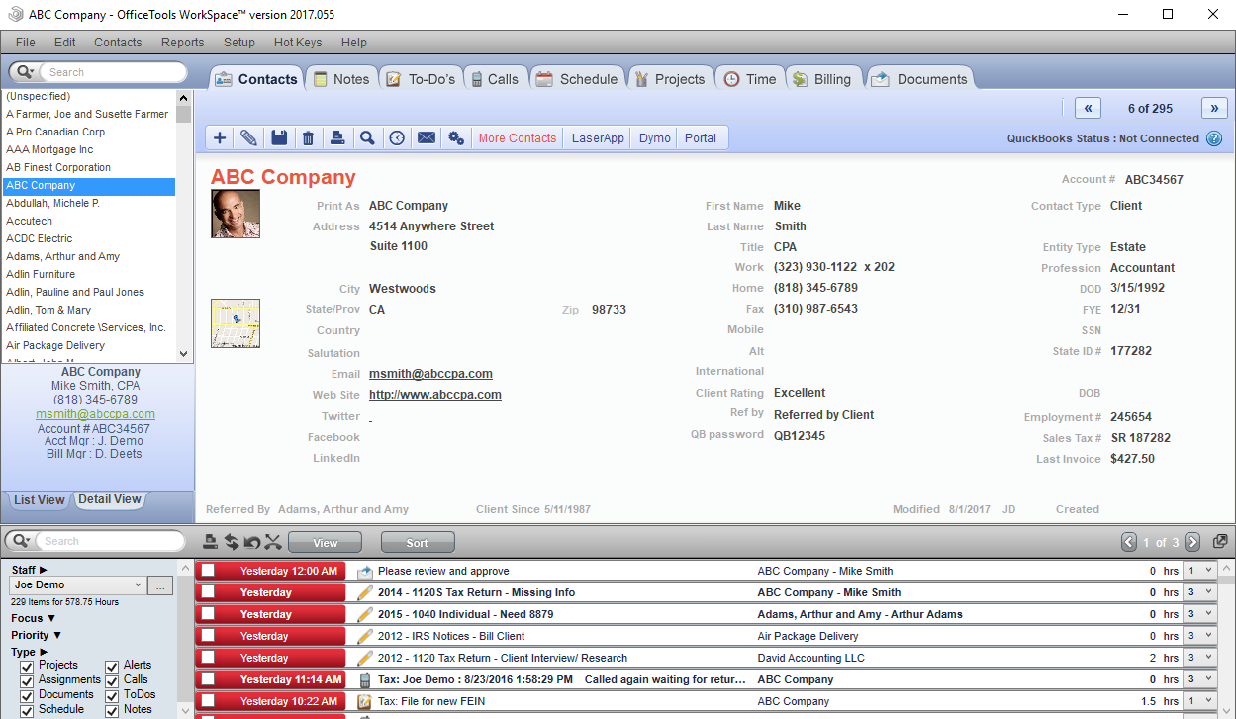
Course: 1 Introduction to OfficeTools
Introduction to OfficeTools and its scope within the Public Accounting Profession
This is a general overview of the profession and the applications place within it.
This session sets the foundation for “What is” OfficeTools and “Why” Accounting professionals need it.
This course should be attended by anyone who will be working with OfficeTools applications or clients.
Video demonstration with sound is included
Created by : Philip Phares

Slide 2
Sales and Marketing Perspective

Slide 3
What are some of the problems facing CPA’s when it comes to Practice/Firm Management?
Too many applications (Tax Prep, GL, CRM, Time/Billing, DMS etc..)
Inconsistent processes
Unmanageable workflow; both in services and administration
Current competitors are far to complex for most users
Number of input transactions (1 client = 100’s of data points across multiple applications)
Unclear or nonexistent tools for Delegation, Accountability and KPI’s

Slide 4
How does OfficeTools solve these problems?
Combines multiple applications into a SINGLE SCREEN interface.
Streamlines and creates consistent processes
Custom creation and detailed tracking of Projects (workflow)
Simple to navigate
Minimum clicks needed to access all client data
Tools for all levels of the firm; From Partner to Intern
Profession specific functionality, single vertical

Slide 5
Who buys OfficeTools?
CPA’s and other accounting professionals, including EA’s and Bookkeepers
5-15 Staff (as few as 1, as many as 100)
When polled, 60% say workflow is their primary need
40% of firms DON’T HAVE any Practice Management solutions, and many have never used a practice management system before.
Managing Partners & Administrative/Office Managers will typically be the champions of the application. They are the first ones to see the value.

Slide 6
Accounting “Cycle” for Sales, Service and Support
Most public accounting firms go “silent” from January till May, then less so in September thru November due to Personal and Corporate tax seasons and extension deadlines.
Tax seasons can represent a majority of the annual revenue for the firm and it is CRITICAL that all applications, training, and support be done PRIOR to tax season. The last thing a firm wants is to buy, implement or do anything with software during this time.
*These graphs are to demonstrate the “trends” within the accounting vertical and should not be used for budgeting or other KPI based decisions

Slide 7
General Features & Functionality

Slide 8
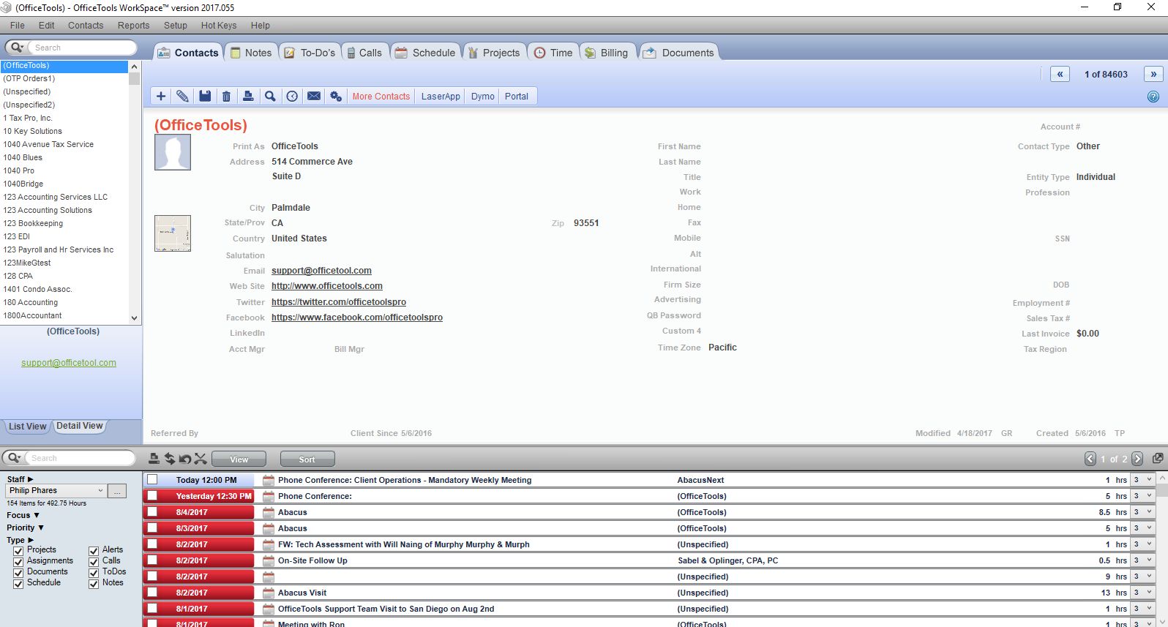
OfficeTools Training & Demo

Slide 9
Main Features Summary
*Excluding Add-ons, Syncs & Integrations
CRM – Entity focused contact management
Note Tracking - Detailed Contact specific Notes; task specific notes
To-dos – Single staff, single task tracking with reoccurring functionality and notifications
Call Tracking- Phone Call reminders, logging and tracking.
Schedule- Multi Staff & View event focused Calendar, syncs with Outlook
Projects – Multi Staff, Multi Task workflow with Due-date tracking, documents, budgets, checklist etc.
Time – Task integrated time sheets, time cards and timers
Billing – Full featured WIP, A/R and Payment system. Supports all common billing methodologies.
DMS- Task integrated list style document management with custom categories and project association
Staff Activity List – Staff managed and focused alert and notifications.

Slide 10
CRM
Entity focused contact management
Multiple Entity and contact type specific fields
5 Custom fields (3 drop downs, 2 open text)
Customizable Form Letters with 3 different styles; Contact, Project and Appointment
Custom Contact types/professions
Custom Contact Groups
Mass/bulk Email generation
Contact Syncs with Lacerte, QuickBooks, Profile & Outlook via Add-on utilities
Bulk Contact info import via Excel

Slide 11
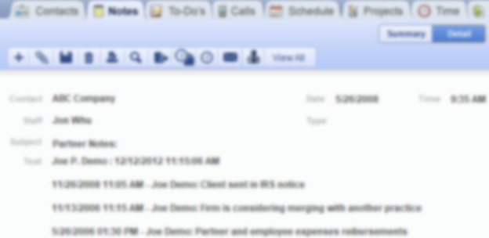
Notes
Detailed Contact specific Notes
Dedicated contact focused Note system.
Task Specific Note & Results tracking
Management window with historical system wide note aggregation
Project Specific Note tracking with roll-over functionality
Staff assignable Notes with notifications
Document Management integration

Slide 12
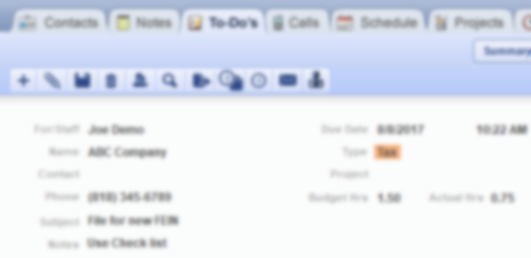
To-Do’s
Single step task tracking system
Quickly create a single staff task with custom reoccurrences
Supports auto time cards and timers
Custom Event types available
Ability to connect to a project for time tracking, reporting & reference
Document Management integration
Notifications and alerts

Slide 13
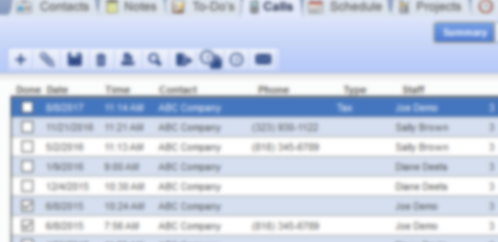
Calls
Phone Call reminders, logging and tracking.
Quickly create a phone call reminder for any staff member
Supports auto time cards and timers
Custom Event types available
Ability to connect to a project for time tracking, reporting & reference
Document Management integration
Notifications and alerts
Unique graphical identifiers for quick visual differentiation

Slide 14
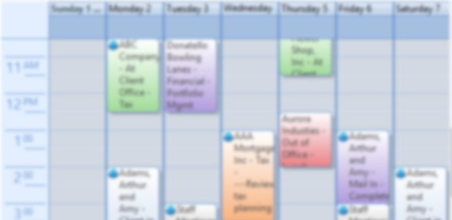
Schedule
Schedule- Multi Staff & View event focused Calendar, syncs with Outlook
Multiple Staff visible and manageable from single calendar
Day, Week, month views, with undock able calendar for multi-monitor support
Text and email reminders
Portal integration
Custom Event types available
Ability to connect to a project for time tracking, reporting & reference
Document Management integration
Notifications and alerts
Unique graphical identifiers for quick visual differentiation

Slide 15
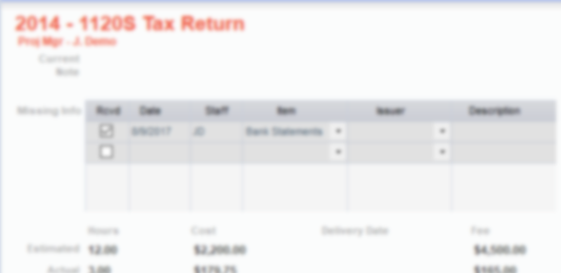
Projects
Projects – Multi Staff, Multi Assignment workflow
Pre-definable Assignment workflow tracking
Highly customizable and configurable
Built around Tax & Accounting workflow practices
Center piece of OfficeTools, combines almost all other features into a single screen
Project specific Document Management
Detailed Budgeting
Reoccurring based on completion with date and description advancement (2015,2016,2017)
Auto assigning based on user defined workflow and assignment completion.

Slide 16
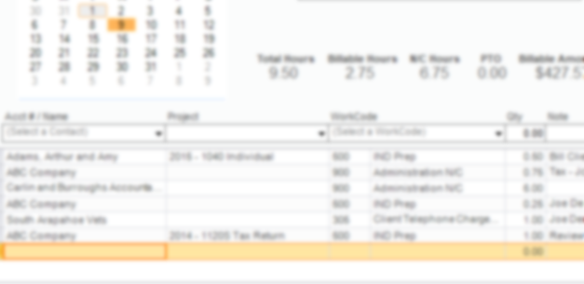
Time Tracking
Time – Task integrated time sheets, time cards and timers
Task focused
Accessible from all areas of the application
Auto created when tasks are completed
Multiple timers
Defaulted fields to speed up input
Payroll and Billing from same system

Slide 17
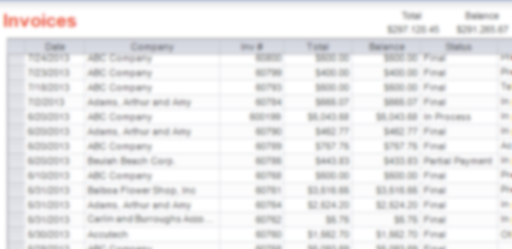
Billing
Billing – Full featured WIP, A/R and Payment system.
On-screen WIP management and instant posting of billable time
Detailed billing codes and rate management
Highly customizable invoice creation
Automatic reoccurring invoicing, with WIP association
Portal Integration
QuickBooks Integration
Full payment system with deposit reporting
Detailed reporting
Integrated with staff and project budgeting system

Slide 18
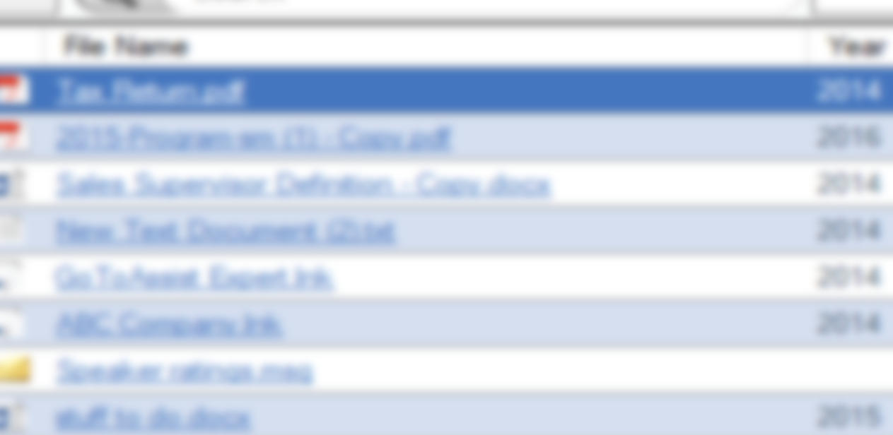
DMS
DMS- Task integrated list style document management with custom categories and project association
Native format stored “locally” on mapped drive
List view removes need to “hunt” for nested folders
Portal integration
Task attached documents
PDF Print driver with Scan Folder
Custom categories

Slide 19
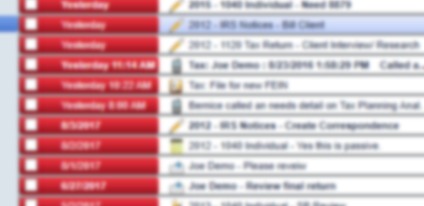
Activity List
Staff Activity List – Staff managed and focused alert and notifications.
Multiple staff and team views
Multiple sorts, views and filters
Actionable, allows for completion, re-assigning and time tracking
Short cuts to specific task for quick navigation
Un-dockable for multi-monitor support

Slide 20
Video Demonstration link
Click here and adjust your sound

Slide 21
What did we learn?
Hope you took notes…..

